Slide 1
AI-Driven Analysis on LFW ‘25
LANCASTER UNIVERISTY GHANA
BY: ANITA DIJALA
Computer Science
Supervisor: Fredrick ….
Year: 3

Slide 2
01
PROBLEM & MOTIVATIONS
SLIDESGO 20XX
WHY THIS TO SOLVE WHAT?

Slide 3
Problem Statments
Fashion trend analysis is largely manual and subjective
Limited data-driven analysis for African fashion collections
Designers and marketers lack quantitative insights into colour and fabric trends
Runway imagery is large-scale and difficult to analyse manually
Notes:
Fashion trend analysis is largely manual and subjective
Limited data-driven analysis for African fashion collections
Designers and marketers lack quantitative insights into colour and fabric trends
Runway imagery is large-scale and difficult to analyse manually

Slide 4
02
SYSTEM OVERVIEW
SLIDESGO 20XX
Architechure diagram

Slide 5
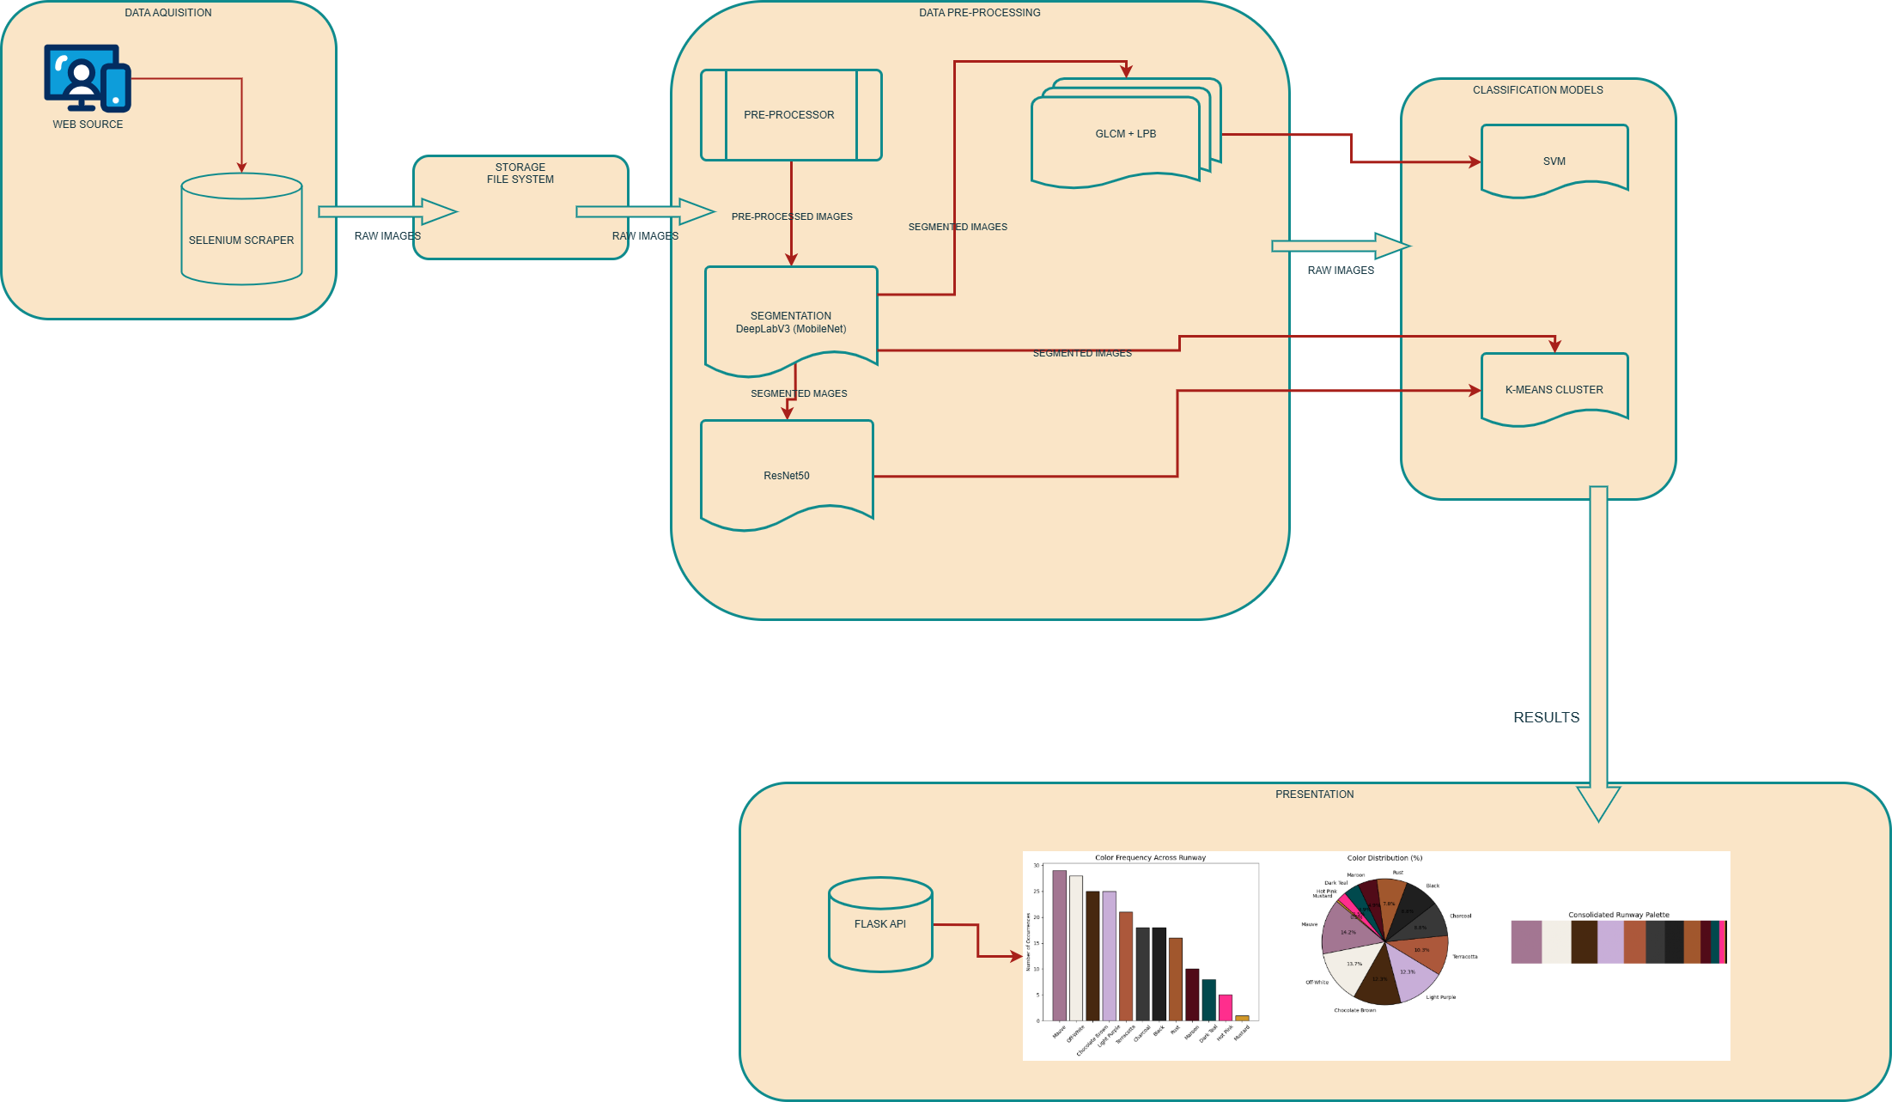
Notes:
The system scrapes runway images, preprocesses them, extracts texture and colour features, then applies machine learning models to classify fabrics and cluster colour palettes. Results are visualised in a web dashboard.

Slide 6
03
SOFTWARE ARCHITECTURE
SLIDESGO 20XX
Architechure diagram Layers

Slide 7
SOFTWARE ARCHITECHURE
DATA LAYER
Runway image dataset
JSON statistical outputs
BACKEND
FastAPI
Feature extraction scripts
ML models
FRONTEND
React dashboard
Charts and palette visualizations
Notes:
The backend processes image analytics and exposes APIs, while the React frontend consumes these APIs to generate interactive visualisations of colour trends and brand-level insights.

Slide 8
04
USE CASE
SLIDESGO 20XX
Architechure diagram Layers

Slide 9
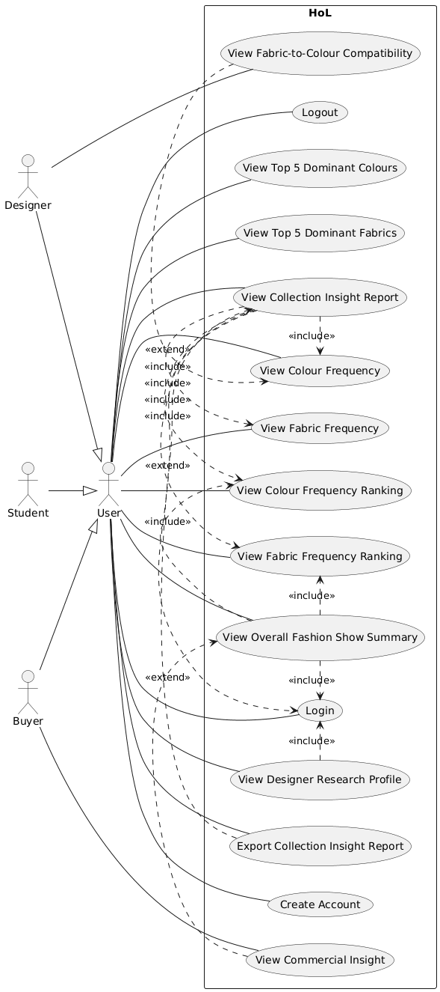
USE CASE
Notes:
The system enables fashion stakeholders to analyse runway collections, identify dominant colours, and observe emerging trends across designers.

Slide 10
05
CHALLENGES & SOLUTIONS
SLIDESGO 20XX
How did you do it…

Slide 11
CHALLENGES
Challenges | SOLUTION
Limited dataset availability | Web scraping runway images
Inconsistent lighting in images | Image Processing
Complex textures in fabrics | Feature extraction (GLCM + LBP)
Colour variation | K-means clustering
Notes:
Inconsistent lighting in images

Slide 12
06
DEMO
SLIDESGO 20XX
How did you do it…

